Slide 1

Finding the number of customers with a timely response rating of 4 or greater, using city, state, services, and type of internet used
Overall measure of services
Customer information
Response time for services given

Slide 2
Patients respond time for support given
Do customers meet the threshold of a timely response rating of 4 or greater?

Slide 3

Created service table using “public.services" as the key
CREATE TABLE public.services
(
customer_id character varying(30) COLLATE pg_catalog."default" NOT NULL,
internerservice character varying(25) COLLATE pg_catalog."default",
phone character varying(4) COLLATE pg_catalog."default",
multiple character varying(4) COLLATE pg_catalog."default",
onlinesecurity character varying(4) COLLATE pg_catalog."default",
onlinebackup character varying(4) COLLATE pg_catalog."default",
deviceprotection character varying(4) COLLATE pg_catalog."default",
techsupport character varying(4) COLLATE pg_catalog."default",
CONSTRAINT services_pkey PRIMARY KEY (customer_id)
)

Slide 4
Created survey responses table using “public.survey_responses" as the key
CREATE TABLE public.survey_responses
(
customer_id character varying(30) COLLATE pg_catalog."default" NOT NULL,
timely_response integer,
timely_fixes integer,
timely_replacement integer,
reliability integer,
options integer,
respectful integer,
courteous integer,
active_listening integer,
CONSTRAINT survey_pkey PRIMARY KEY (customer_id)

Slide 5
Created two separate queries and combined both to find total number of customers by service, city, state , and timely response rating is 4 or greater , order the total number of customers desc from higher to lower
SELECT count(cust.customer_id) as total_customers, ser.internetservice, loc.state, loc.city from customer cust
JOIN location loc
ON cust.location_id = loc.location_id
JOIN services ser
ON cust.customer_id = ser.customer_id
JOIN survey_responses sur on cust.customer_id = sur.customer_id
WHERE sur.timely_response = >4
GROUP BY 2, 3, 4
ORDER BY 1 DESC

Slide 6
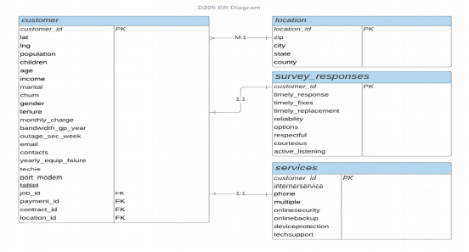
Table | Field
customer | customer_id
customer | multiple
survey Responses | customer_id
survey Responses | timely_responses
services | customer_id
services | internetservices

Slide 7
The research question requires analysis of customer and location tables from the original fields given. Services and survey_responses tables from add-on CSV data sets to answer this question. The customer table has customer information, and the location table has customer location information such as city, state, and zip code. Services table has the different type of internet services the customer used. The survey_responses table has various ratings of timely_fixes, responses_given, and timely_responses.
SELECT count(cust.customer_id) as total_customers, ser.internetservice, loc.state, loc.city from customer cust
JOIN location loc
ON cust.location_id = loc.location_id
JOIN services ser
ON cust.customer_id = ser.customer_id
JOIN survey_responses sur on cust.customer_id = sur.customer_id
WHERE sur.timely_response = >4
GROUP BY 2, 3, 4
ORDER BY 1 DESC

